Slide 1

NEXT HIKES IT SOLUTIONS PVT LTD
HARSH RANJAN
PROJECT_1
SUBMISSION DATE – 20/01/2026

Slide 2

Objectives -:
To analyze bike-sharing demand and understand how factors such as weather, time, holidays, and user type influence rentals.
To apply Excel data handling skills including data cleaning, merging, and transformation of multiple datasets.
To identify patterns and trends in bike usage over hourly and daily periods.
To create pivot tables, charts, and dashboards for meaningful business insights.
To automate data processing and reporting using Excel features, VBA, and AI-powered tools.
To support better business planning and decision-making through organized and visualized data.

Slide 3

Dataset
The project uses three bike-sharing related datasets:
Dataset 1: Bike rental data (hourly/daily usage, user counts, date and time information).
Dataset 2: Weather data (temperature, humidity, wind speed, weather conditions).
Dataset 3: Calendar and contextual data (working day, holiday, weekday/weekend indicators).
The datasets are merged using common keys such as : -
instant
dteday
hr
Data is sourced from Google Sheets and Excel files and imported into Excel for analysis.
These datasets together enable comprehensive analysis of demand behavior under different conditions.

Slide 4
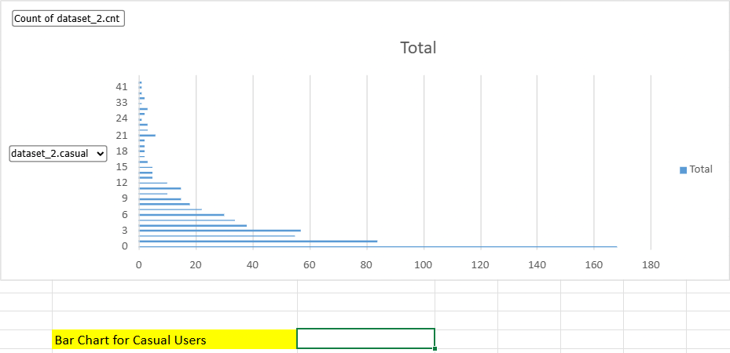
Bar Chart Visualization – Casual Users
Hour 0 (Midnight) has the highest count (168), indicating a large number of casual rentals recorded at this time.
Early hours (1–4 AM) show moderate activity, with a gradual decline afterward.
From morning to afternoon (5–16 hours), the count steadily decreases, indicating lower casual usage.
Very low activity is observed during late evening and night hours (17–23).
Casual users tend to rent bikes sporadically, unlike registered users who usually follow commute patterns.

Slide 5
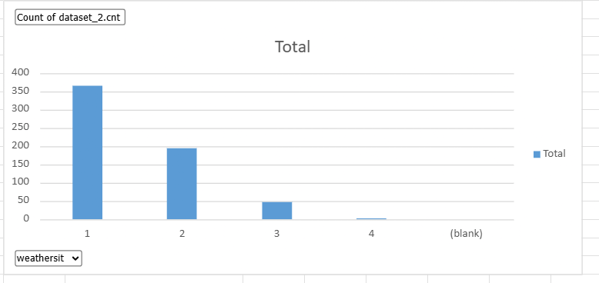
Clustered Column Chart
Key Observations
Weather Situation 1 (Clear weather) has the highest count (365), indicating maximum bike usage.
Weather Situation 2 (Mist/Cloudy) shows a moderate number of rentals (193).
Weather Situation 3 (Light Rain/Snow) has significantly lower rentals (47).
Weather Situation 4 (Severe weather) has almost no rentals (1).
Blank values are negligible and do not impact the overall trend.
Business Insights
Bike rentals are highly dependent on weather conditions.
Clear and mildly cloudy weather encourages users to rent bikes.
Poor weather conditions drastically reduce demand.
Operations and bike availability can be optimized based on weather forecasts.

Slide 6
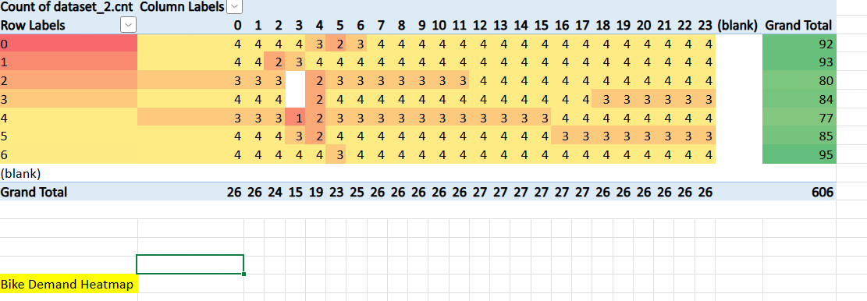
Heatmap
Key Observations
Bike demand is consistently high during most daytime hours (8 AM – 6 PM) across favorable weather conditions.
Weather conditions 5 and 6 show higher overall demand, indicated by darker shading across multiple hours.
Early morning and late-night hours show relatively lower demand, especially under unfavorable weather.
Demand drops noticeably in poor weather conditions, even during peak hours.
Business Insights
Bike usage is strongly influenced by a combination of time and weather.
Operators can increase bike availability during high-demand hours in favorable weather.
During adverse weather or low-demand hours, resources can be reduced to optimize operations.
Heatmaps are highly effective for identifying peak-demand windows at a glance.

Slide 7
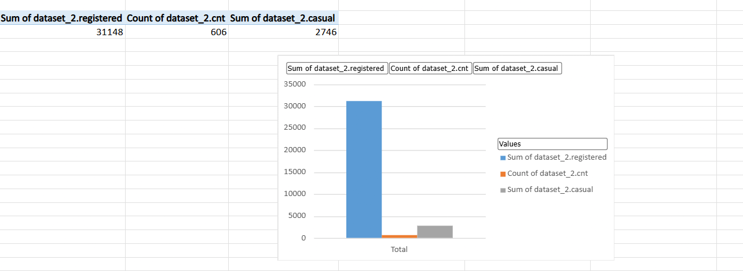
Stacked Bar Chart
Key Observations
Registered users dominate bike usage, contributing the vast majority of total rentals.
Casual users form a much smaller portion of overall demand.
The high registered-user count indicates that bikes are primarily used for regular or commuting purposes.
The count of records confirms the dataset covers 606 data points.
Business Insights
Bike-sharing demand is driven mainly by loyal, registered customers.
Retention strategies for registered users are critical for stable demand.
Casual users represent an opportunity for marketing and conversion into registered users.
Subscription plans and commuter-focused services can further boost usage.

Slide 8
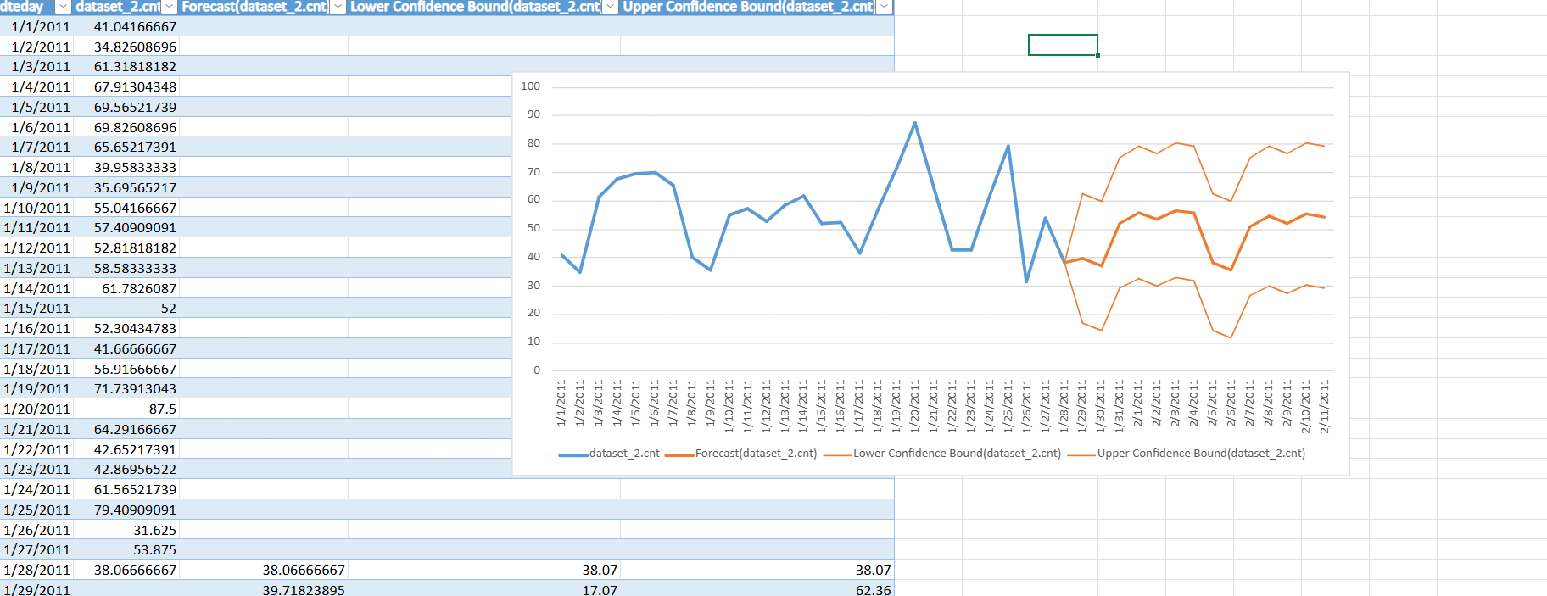
Forecast Sheet
Key Observations
Historical demand shows fluctuations with peaks and drops, indicating seasonal and daily variability.
Forecasted demand follows a stable upward pattern, suggesting consistent future usage.
Confidence bounds widen slightly, showing uncertainty increases over time.
Most forecasted values remain within reasonable range of historical demand trends.
Business Insights
Forecasting helps in planning bike availability and maintenance schedules.
The confidence interval provides a risk buffer for demand planning.
Operators can prepare for higher demand periods while minimizing idle resources.
This analysis supports data-driven decision-making for inventory and operations.

Slide 9
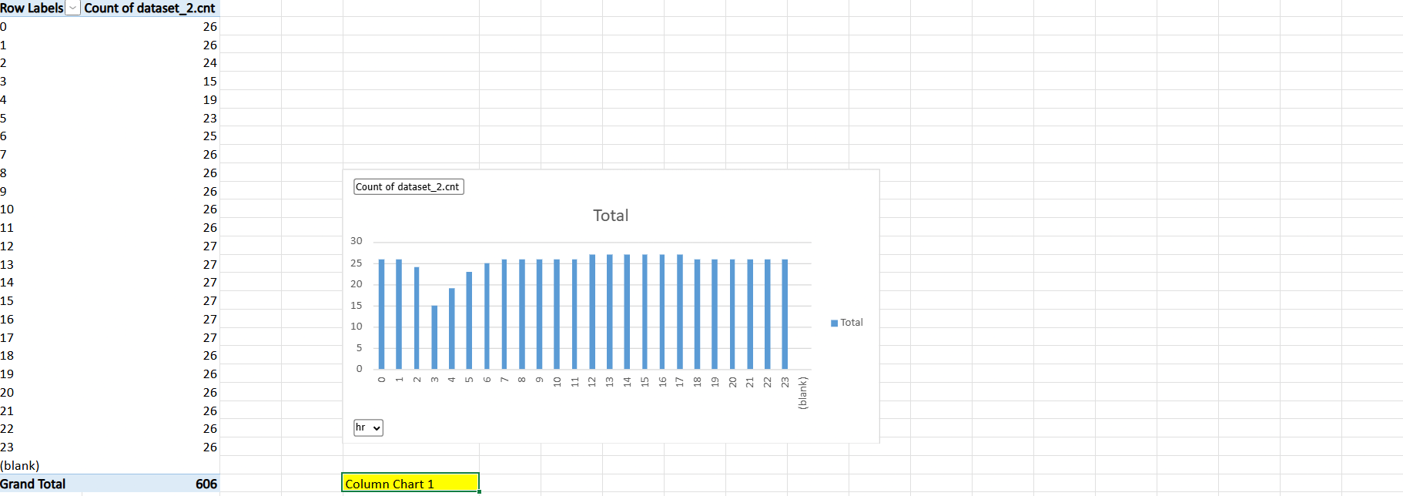
Column Chart
Key Observations
The count of records is fairly uniform across most hours, ranging between 25–27 records.
A slight dip is visible around hours 3–5, indicating fewer observations during early morning hours.
From 6 AM to late evening, the data is consistently recorded, showing balanced data coverage.
The Grand Total of 606 records confirms complete hourly coverage in the dataset.
Business Insight
Since data is evenly distributed across hours, the dataset is reliable for hourly analysis.
No major data gaps exist, ensuring accurate trend and demand analysis.
This consistency strengthens the validity of hour-based demand forecasting and visualization.

Slide 10
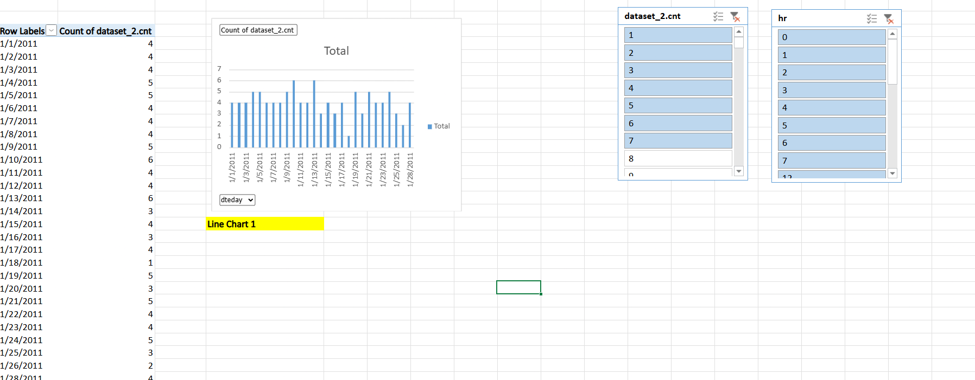
Line Chart
Key Observations
Daily record counts fluctuate between 1 and 6 entries per day.
Most days have 4–5 records, indicating consistent data collection.
A noticeable dip occurs around mid-January, where counts briefly drop.
No extreme spikes are observed, suggesting stable and reliable data capture.
Business Insights
Consistent daily records indicate high data quality for trend analysis.
Interactive slicers allow users to analyze demand patterns by specific hours or count ranges.
This visualization helps validate the dataset before performing advanced analysis or forecasting.

Slide 11

Challenges
Data cleaning and handling missing values
Merging multiple datasets accurately
Managing large volumes of hourly and daily data
Interpreting weather condition codes
Performing time-based analysis (hourly, daily, weekday/weekend)
Selecting appropriate charts and visualizations
Ensuring accuracy in demand forecasting
Automating tasks using VBA macros
Converting analysis results into business insights

Slide 12

Conclusion
The case study successfully analyzed bike-sharing demand using Excel-based data analysis techniques.
Weather conditions, time of day, and user type were identified as key factors influencing bike rentals.
Registered users contributed the majority of total bike demand, indicating commuter-driven usage.
Data visualization and dashboards made trends and patterns easy to understand.
Forecasting helped predict future demand and supported better operational planning.
Overall, the study demonstrated how structured data analysis leads to informed business decisions.

Slide 13

Thank You

